Slide 1
MID BOOTCAMP PROJECT
Apartment rental offers in Germany

Slide 2
Introduction
The data was scraped from Immoscout24, the biggest real estate platform in Germany.
The data set contains offers from the dates 2018-09-22 to 2019-10-08.
There is different information regarding regions, total rent, base rent, has a balcony or not, number of rooms, heating type, etc.
This dataset has 261868 rows and 20 columns.

Slide 3

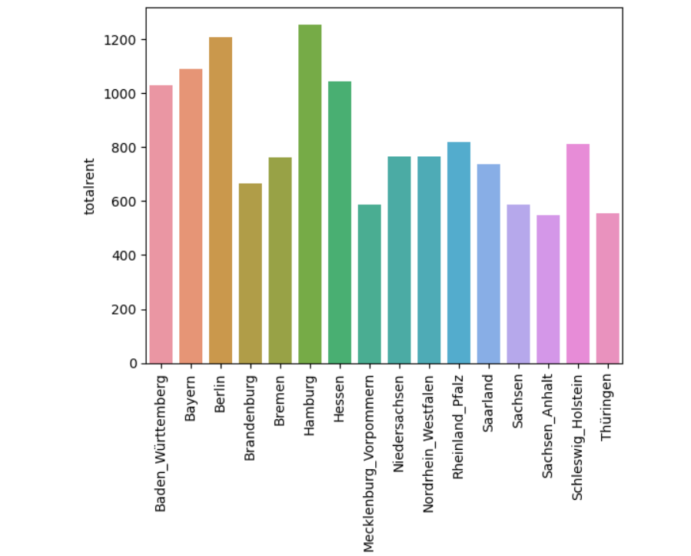



What is the average rent for apartments in different regions? Visualize the results.
I have calculated the average rent for all 16 regions.
The highest average rent is in Hamburg and the lowest one is in Thüringen.
But in this case, we are not taking into consideration the surface of the house so we can not have a correct prediction. What next?

Slide 4
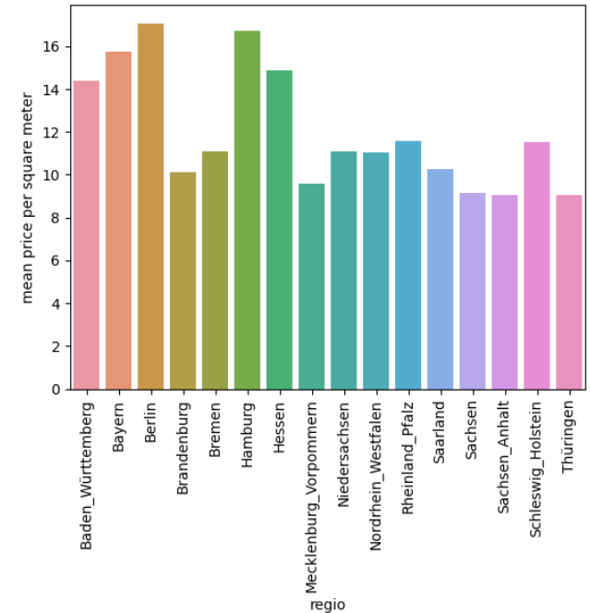
What is the average rent for apartments in different regions? Visualize the results.
After calculating the price per square meter for all the apartments than we can do a reasonable comparison.
Considering the following graph, the average price seems to be different with the highest price in Berlin and the lowest still in Thüringen.
Considering that in our dataset there are many other factors we should take into consideration others too.

Slide 5
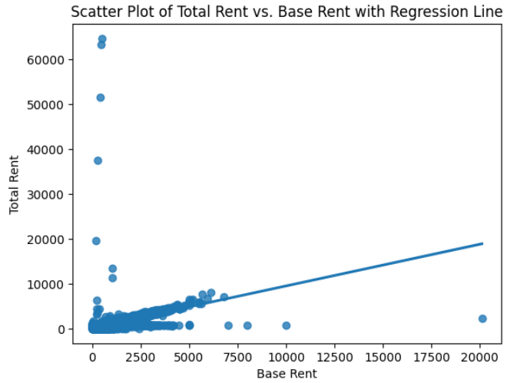
Is there any relationship between base rent and total rent?
In the dataset we have both rents, total rent, and base rent.
In the following scatter plot, we can see the correlation between total and base rent.
From the scatter plot we can see that total rent and base rent are highly correlated.

Slide 6

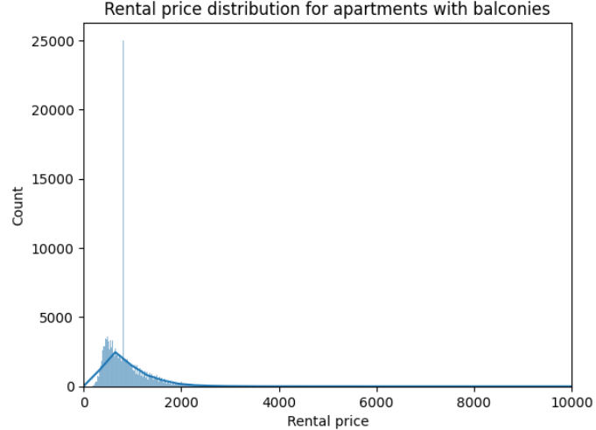
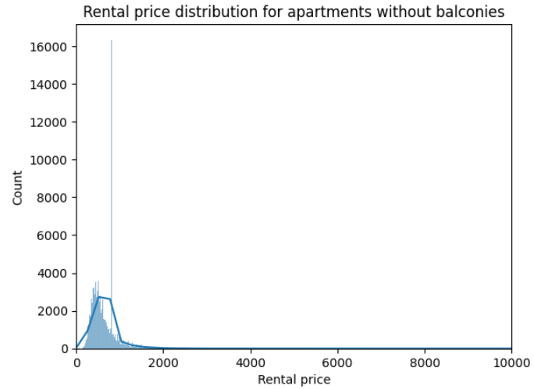
Does the presence of a balcony impact the price of the apartments?
Since base and total rent prices are highly correlated, I am analyzing if the balcony has an impact on this price.
Taking into consideration the plots they indicate that the total price of rent is not much influenced by the fact if a house has a balcony or not.
In this I assumed that an important factor might be the number of rooms.

Slide 7
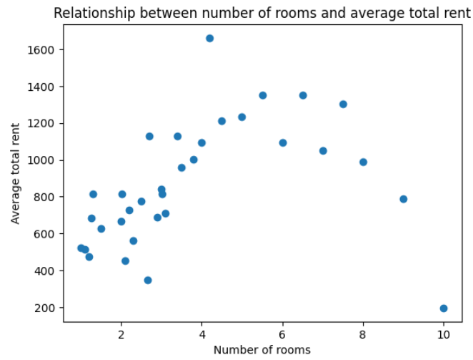
Visualize the relationship between number of rooms and total rent.
Taking as an indicator the average total rent that I computed earlier I have grouped the number of rooms.
As the number of rooms increases, the average total rent also tends to increase. There is a clear positive correlation between the number of rooms and the average total rent.
This suggests that apartments with more rooms tend to be more expensive. However, there is some variation in the data, with some apartments having higher or lower rents than expected based on the number of rooms.

Slide 8
Conclusions
17.141712134339365
In this dataset there are many variables that can be analysed and have an impact on the total rent price.
So far from my analysis the region with the highest average price per square meter is Berlin = 17.14 and the lowest Thüringen = 9.04.
Base and total rent are highly correlated with each other so the increase of price in base rent affects total rent too.
Balcony is not one of the most important factors which affect the price of rent.
On the other hand, when the number of rooms increases, the average total rent also tends to increase, so this is an important indicator and factor in the rent price.

